Slide 1
Classification
Team 7
Notes:
Answer to Aiden’s question about predicting training data in question (f): We are supposed to be predicting the training error as we are training the model.

Slide 2
Methods
Logistic Regression
LDA (Linear Discriminant Analysis)
QDA (Quadratic Discriminant Analysis)
KNN (K Nearest Neighbors)
Notes:
Naive Bayes and Bayes Classifier are early and worth covering if we have time
One of the professors main ideas was to focus on comparing the models and the differences for them than on describing the full model.
She advises having a similar discussion pattern for various models. I,E. if you discuss the mathematical underpinnings of one model, you should for the other models.

Slide 3
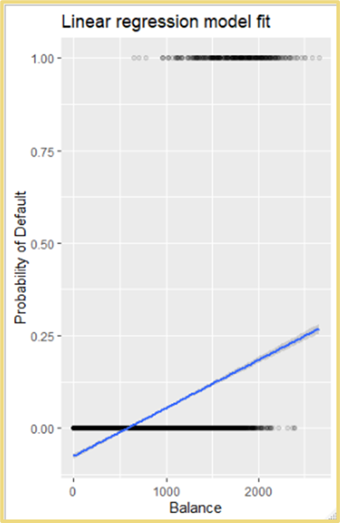
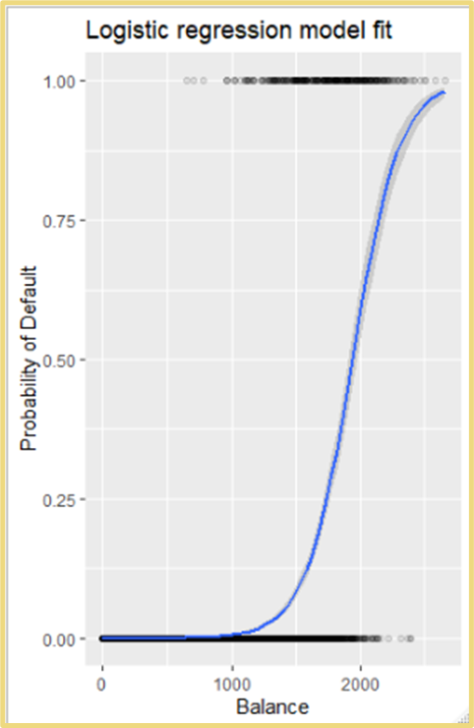
Logistic Regression
Logistic regression does not automatically classify predictions
Necessitates ifelse(p>.5, class1, class2)
Mathematically, logistic curve fits data with two classes much better across a continuous X feature
Linear Regression will never predict the second class
Default, in the case of the graphs on the right

Slide 4
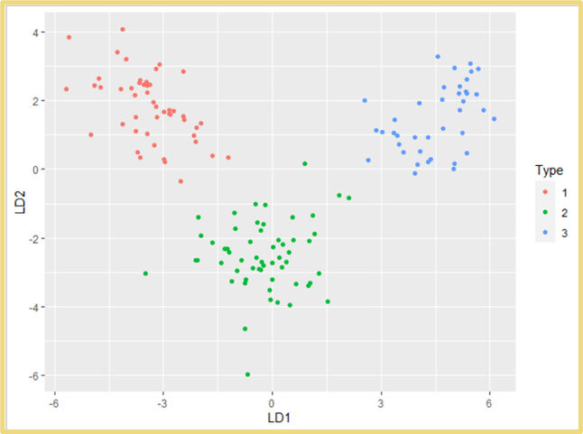


LDA
Puts data points into k predetermined classes
Draws k-1 lines to divide data
Draws boundaries using conditional probability density functions
When classes in categorical data are well-separated, logistic regression models are unstable
LDA is also popular where k classes is greater than 2
Notes:
The slides are primarily review so focus on the differences and when should you use what
Conditional Probability density function
Focus on what separates the different categories
If we cover the math under functions we need to do all of our functions. Including LDA QDA KNN
Functions should have similar bullet points

Slide 5
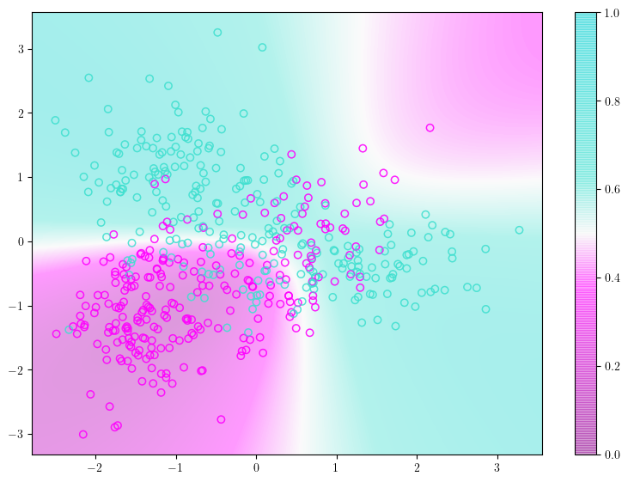
QDA
Compromise between non- parametric approach, KNN, and more linear approaches, LDA and Logistic Regression
Quadratic Decision boundary can accurately model a wider range of problems than linear approaches
Performs better than KNN in cases where there are a limited number of training observations

Slide 6
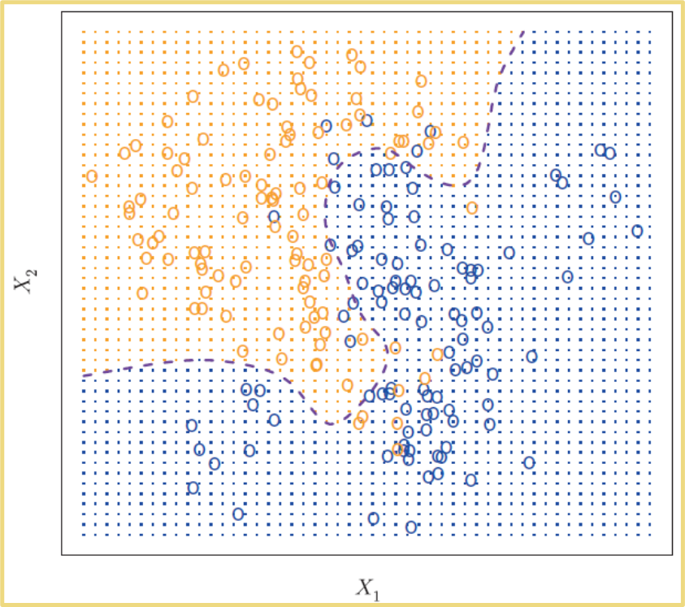

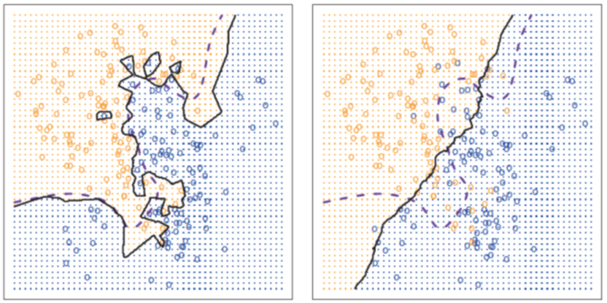
KNN
Classifies data points based on proximity to K nearest neighbors
Boundary is drawn based on point proximity
Point colors are true classes
Boundary will become more nuanced the lower the value of K is
Bias-Variance tradeoff
Overfit
K too small
Underfit
K too large
Notes:
Probably want to define nonparametric data

Slide 7
Assumptions
Predicting a binary or multinomial variable
Absence of strongly influential outliers
Independence of errors
Absence of multicollinearity between variables (Excluding knn)
Logistic | Binary | Linearity of Logit
LDA | Multinomial+ | Normal Distribution
QDA | Multinomial+ | Normal Distribution
KNN | Multinomial+ | Nearby points are similar
Notes:
All qualitative so binary or multinomial
If attempting to predict a variable with more classes, use a different classification method.
Linearity of the logit the relationship between the logit (aka log-odds) of the outcome and each continuous independent variable is linear
Multicollinearity refers to an independent variable being able to accurately predict other “independent variables” this means that these variables are actually not independent
Extremely influential outliers make predictions often have vast differences between predictions and outcomes
If there are duplicate responses in the data or measures have correlated outcomes, the model will find errors that are similarly correlated.

Slide 8
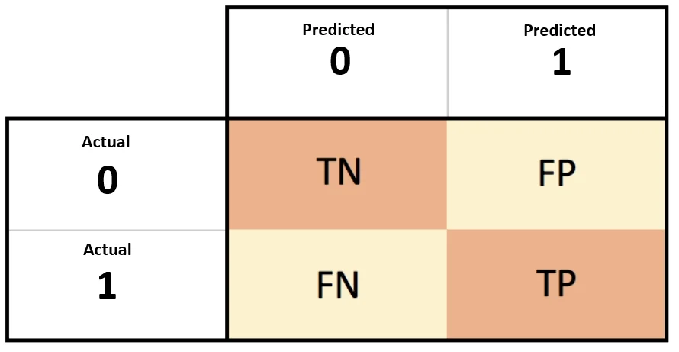
Confusion Matrix
Classification Models with binary target variables often result in a confusion matrix.
Generates a table of True Negatives, False Positives, False Negatives, and True Positives
The confusion matrix makes Accuracy and Error formulas readily available.
Accuracy: (TP+TN)/(TP+FP+FN+TN)
Error rate: (FN+FP)/(TP+FP+FN+TN)

Slide 9
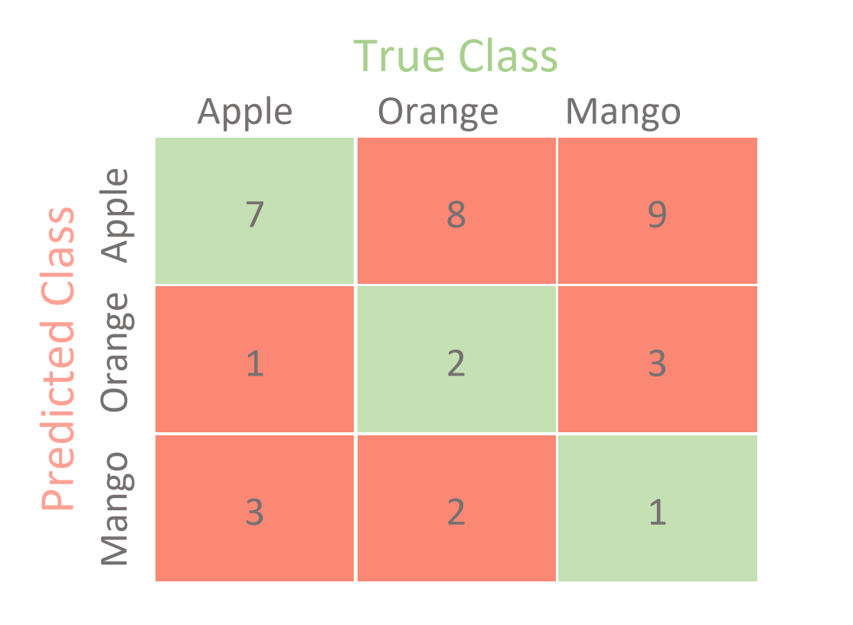
Test Error Rate
The best classifier has the smallest test error rate and best accuracy
Testing displays errors in two classes
False Positive (Type 1 Error)
False Negative (Type 2 Error)
Naive Rule for classification: (Class Imbalance)
Ignore all predictor information and classify all records as the most prevalent class
If the error rate for the model is below the naive error rate, the model is certainly not useful
Notes:
For classification, use a confusion matrix to find Test Error Rate
36 values, Mango is most prevalent class.

Slide 10
Matrix and Values in R
The Confusion matrix
Useful to find the frequency of the two types of errors
Test Error
Easy to calculate test error rate in R using predicted values
Logreg.prob <- predict(Logreg.mod, test, type= “response”)
Pred <- ifelse(Logreg.prob > .5, “Yes”, “No”)
table(Pred, test$default)
# # Pred No Yes
# # No 1927 52
# # Yes 6 14
# # #Test Error Rate
mean(pred!=test$default)
# # [1] 0.02901451
(6+52)/1999
# # [1] 0.02901451
# # #Accuracy
mean(Pred==test$default)
# # [1] 0.9709855

Slide 11
Github Link
https://github.com/akmaccuish/Machine-Learning-2-TP01-Team-7/blob/main/TP01%20Exercise%209-5.R

Slide 12
Kahoot!

Slide 13
Kahoot Question 1
Which method uses nonparametric data?
Linear Discriminant Analysis | Quadratic Discriminant Analysis
Logistic Regression | K Nearest Neighbors

Slide 14
Kahoot Question 2
Which methods expect a standard distribution?
LDA/QDA | Logistic/KNN
None | All

Slide 15
Kahoot Question 3
Calculate the Accuracy for this Confusion Matrix:
1 0
1 5 1
0 4 10
0.25 | 0.5
0.75 | 1/10

